Slide 1
Communicating Technical Information to Nontechnical People
“Any intelligent fool can make things bigger and more complex... It takes a touch of genius - and a lot of courage to move in the opposite direction.”
E. F. Schumacher, British economist

Slide 2

Factors to Consider
“Us Versus Them” Mentality
Analytics professionals see it as black or white… technology will work or it wont
Must be open-minded to see value in non-technical people’s contributions
Come across as power-tripping or superiority complex
Act as a Data Sage (philosopher, possessing immense wisdom)
Be collaborative!

Slide 3

Use Analogies, References & Examples
Use everyday examples
Many technical terms are derived from everyday terms –
Computer desktop – similar to an actual desktop where we do our work
Email address – like a real mail address
Wallpaper – for a wall or phone screen

Slide 4

“Need-to-Know”
Transfer limited accurate information
They need an overview OR specifics only for decision making!
They need to know what something does and how to make it happen… not how and why it does
Avoid temptation of over-explaining –counterproductive!
Example:
“Who won the game?”
You give a quick answer unless follow up questions follow

Slide 5

How Much is TOO Much? 1-on-1
CHALLENGE: Non-Tech person may want simple answer, even if difficult to give one
“well I can give you a simple yes or no because…” and summarize
Ask if the non-tech person would like more information
Don’t overload, but qualify your response
“I can give you a brief overview kind of like cliff notes and then can fill in the blanks where necessary”
Some may choose bare minimum… saves you time

Slide 6

How Much is TOO Much? Presentations
Target presentations to the least technical person in the room
Offer extra info afterwards or in handouts to more technical people
Be available after the presentation for a more in depth discussion or questions
Rarely will the entire room be the exact same level of education, experience, knowledge, training… even in BAPM

Slide 7
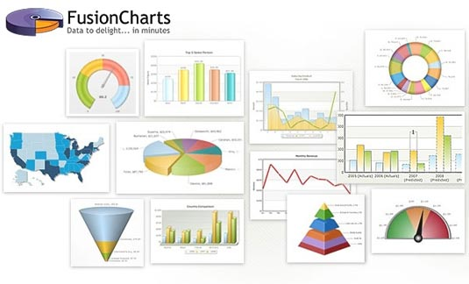
Show Your Work Visually
Growing in popularity and success – technologies such as Tableau, Chart.js, Raw, Dygraphs, ZingChart, Exhibit, Visual.ly, Fusion Charts…. Tens of tools!
Simple and easily absorbed format
SHOW, don’t just tell!
Don’t just show to show, if overwhelming the audience will shut down

Slide 8
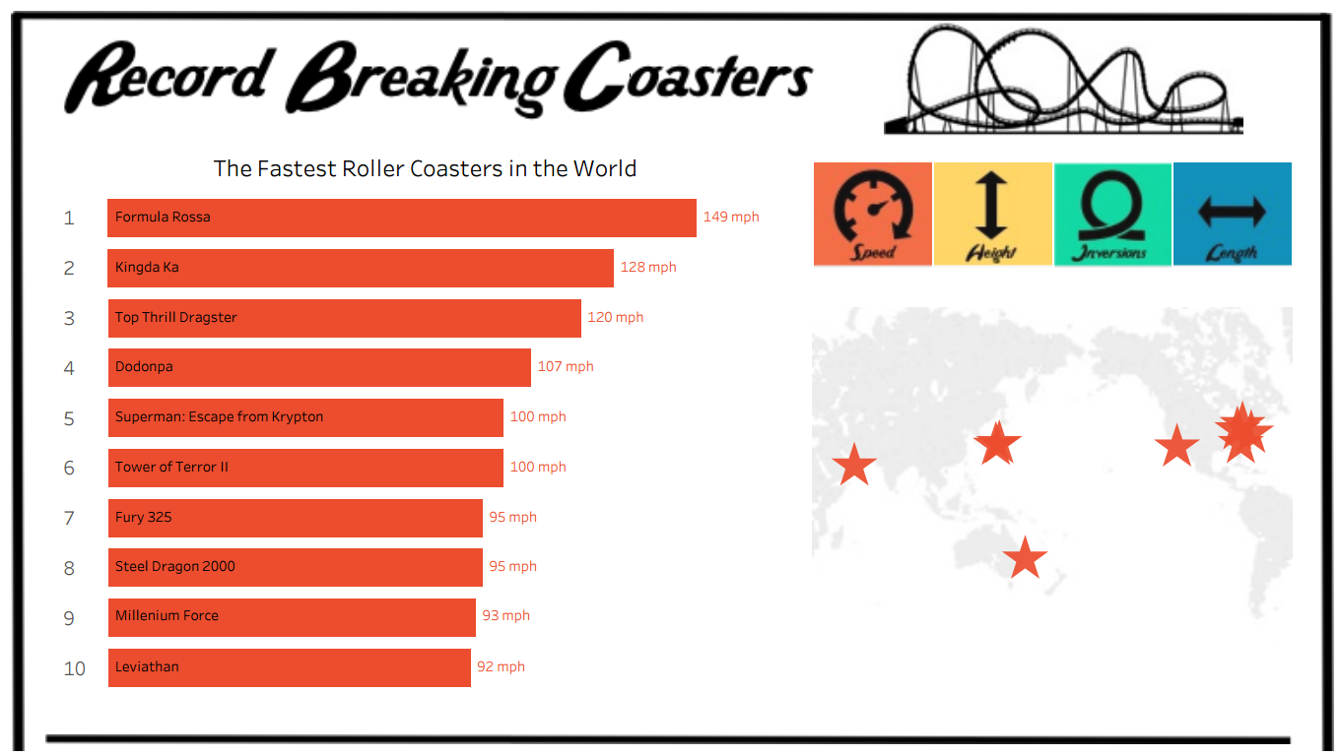
Tips for Enhancing Visual Aids
Take Data Visualization with John Wilson
Keep it simple, Don’t clutter
Use colors appropriately
Make it neat and legible, with large readable fonts
Proofread!
Do not expect the visualization to make your point FOR YOU!

Slide 9

Involve the Listener
Anticipate a breakdown in communication and involve the listener! See it as a collaboration
“Here are the ground rules… I’ll give you info and just stop me at any point if I’m not communicating well.” (assume it’s you, not them)
Allow the listener to give you feedback along the way if your information is too high level, or too low level
Manage the Intimidation
Be aware of physical presence
Do not stand over them, sit if they are seated
Sit or stand next to them – less formal

Slide 10



Preview – Present – Review
Reduces negative factors & frustration
Increases clarity
Use repetition to drive home the message
Tell your audience what you plan to say (concisely), deliver the message, and summarize at the end for accurate retention

Slide 11

Preview
Brief overview
TIP: Mention content AND emotional impact
Examples:
“I want to discuss the results, and I think you’ll be very pleased!”
“There may be some problems with our latest result findings, I’d like to review and see what some possible decisions are.”
Works 1:1 as well, “I’ve reviewed your concerns, there are 2 possible options that we should be able to use.”

Slide 12

Present
This is the “guts” of the presentation
Structure will vary but refer back to “tell them, show them, involve them” (reviewed in Ch. 2)
Pay close attention to words, tone, body language and use of visual aids

Slide 13
Review
Summarize presentation of most important points, themes, recommendations…
TIP: aim to discuss 3 points
Be clear in your number of points and clearly walk the audience through
“First, we…. Second, the results showed… and our third point was to recommend….”

Slide 14

Avoid Thinking Out Loud
Avoid random thoughts, disjointed comments, conjecture, or speculation
PLAN ALL YOUR COMMUNICATION!
Its not how much you know that counts… it’s what your receiver absorbs and comprehends

Slide 15

Your Opinion ≠ Fact
Other analytics experts will know the difference between your opinion and fact, non-technical people will not (most likely)
your opinion will be seen as fact due to your expertise, experience
Your opinions carry weight due to such factors – you have a high level of influence
Your name and credibility will be tied to it
Clearly state when you’re stating your opinion
Your opinions are still extremely valuable and expected sometimes

Slide 16

Help Non-Technical Decision Making
Non-Technical people may make bad choices even if the facts seem clear to you
Often they will wait to get a clearer confirmation from technical expertise
Specifically communicate sound decision making criteria
Make sure non-tech people understand the process you took to get to a conclusion
Be specific and methodical in your communication

Slide 17

Positive Feedback
We all learn best in positive environments
Celebrate “ah-ha” moments
Clearly acknowledge their grasping of information
Human nature is to yearn for continuous positive feedback
Positive environments lead to increased willingness to absorb information
Encourages non-technical people to try even harder to learn the technical info you present

